Slide 1
Setting up a restaurant in the best location

Slide 2
Finding the best location for restaurants is valuable
Interested parties might concern individuals that is starting a new business involving the food industry.
Multi national organizations might even find this project to be benefitial.
As setting up a restaurants in a good location can potentially lead to an increase in visibility indirectly linked to potential revenues.

Slide 3
Data
The number of restaurants within the certain radius of each borough using FourSqaure API
The net income per person in each district (https://www.statistics.gov.hk/pub/B11303012019AN19B0100.pdf)
The population and the population density of the district
The latitude and longitude of the district (https://www.mapcoordinates.net/en)

Slide 4
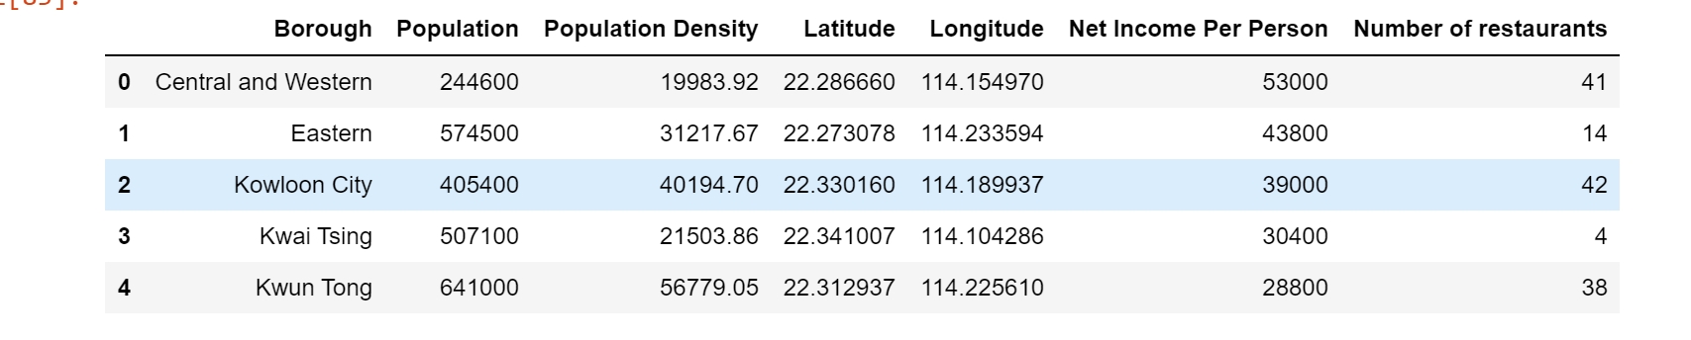
Example of the main data frame

Slide 5
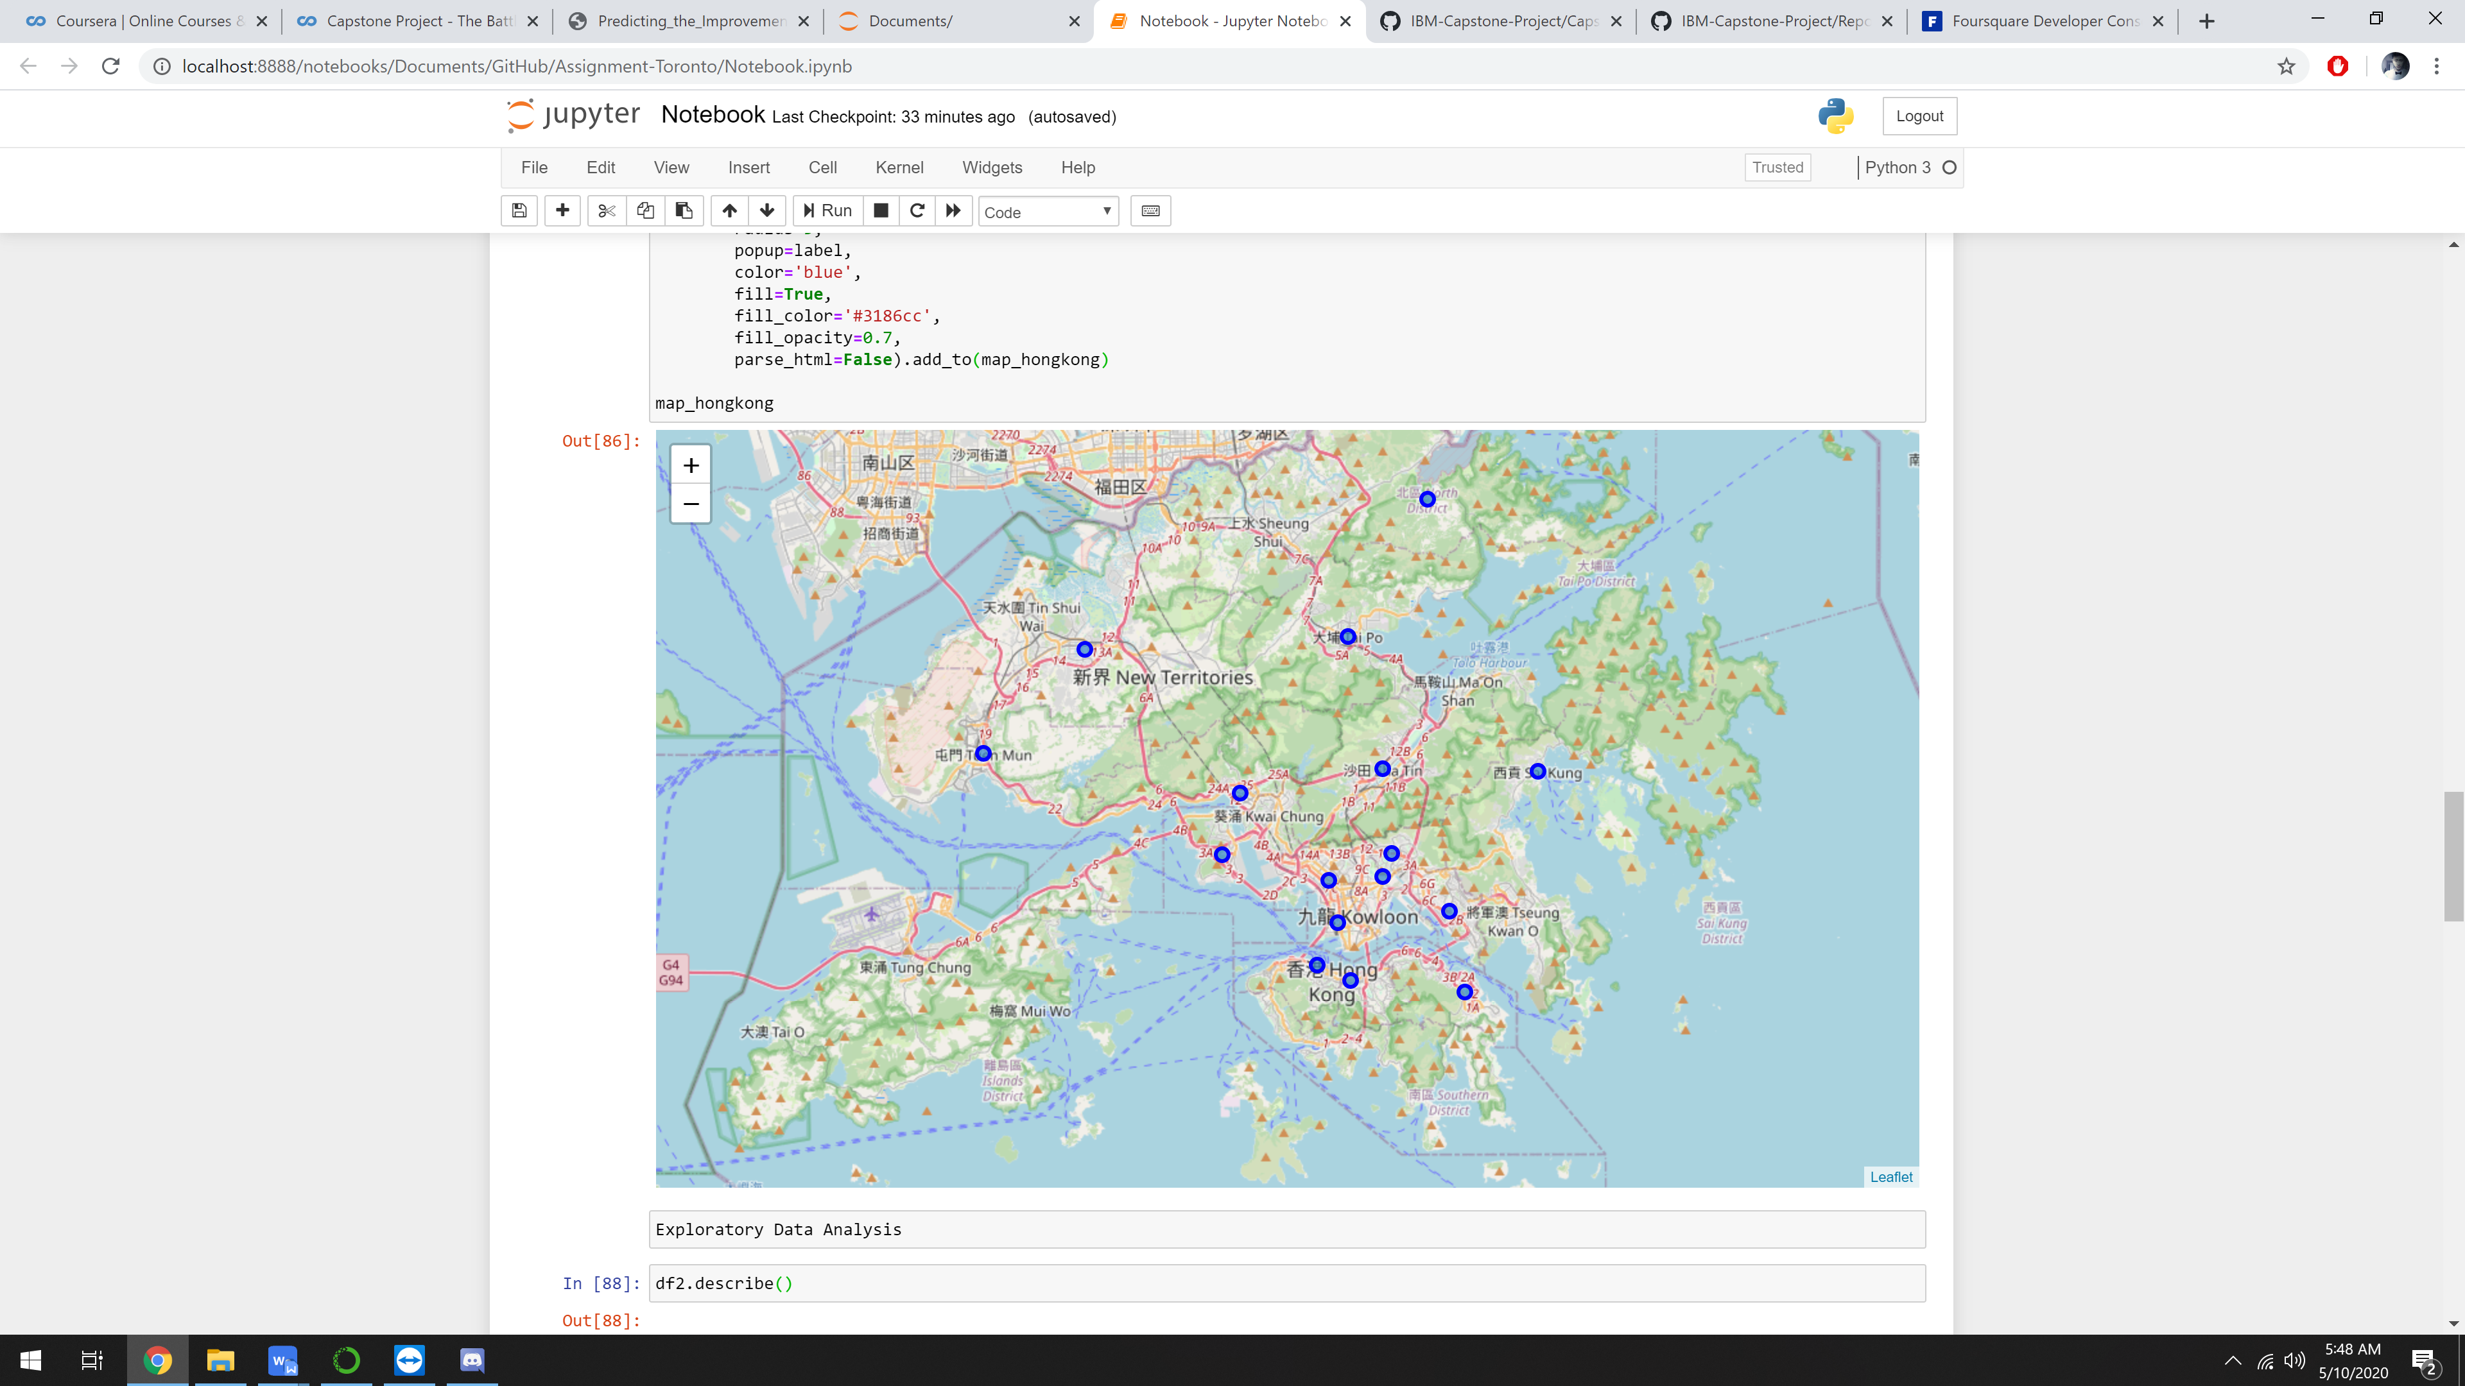
The map of Hong Kong with centers of boroughs

Slide 6
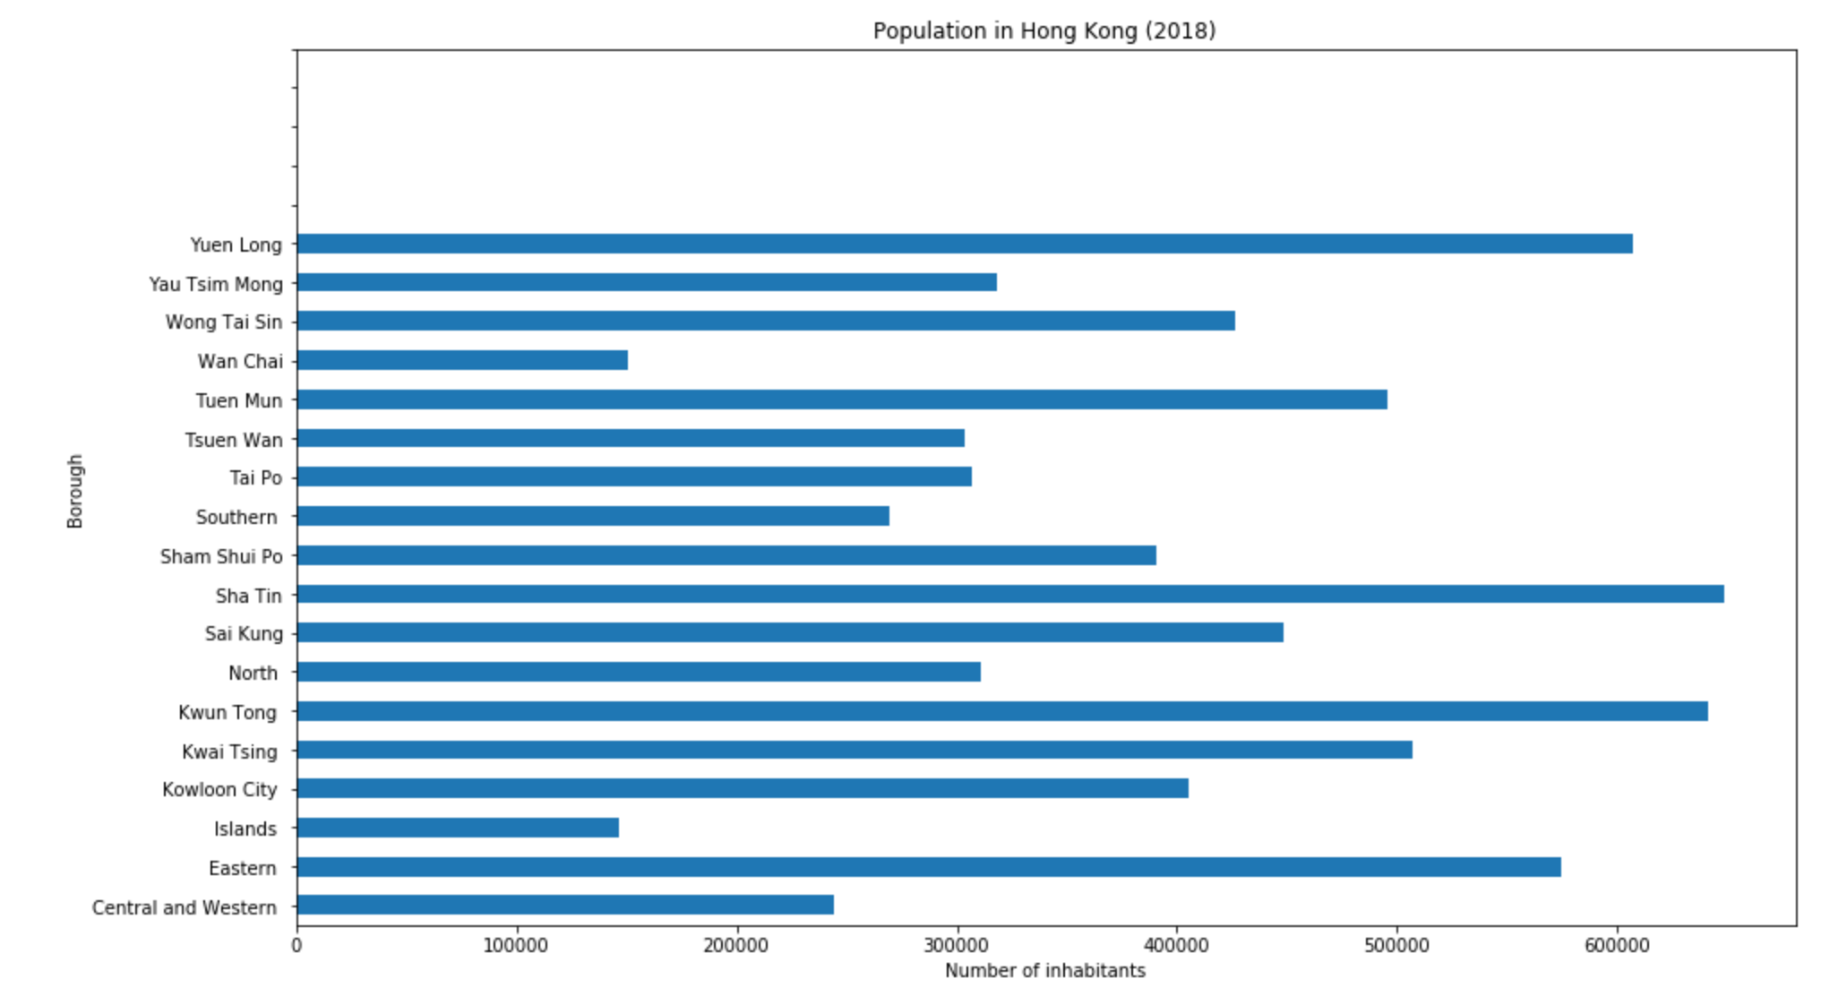
Exploratory Analysis (Population in Hong Kong)

Slide 7
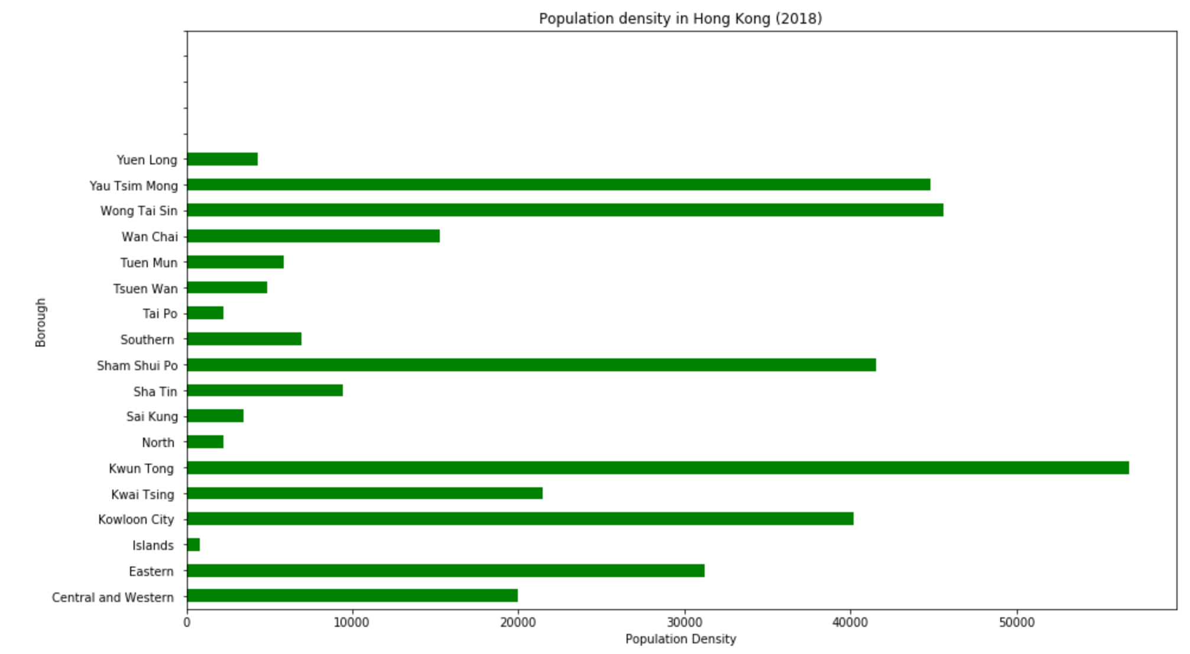
Exploratory Analysis (Population Density in Hong Kong)

Slide 8
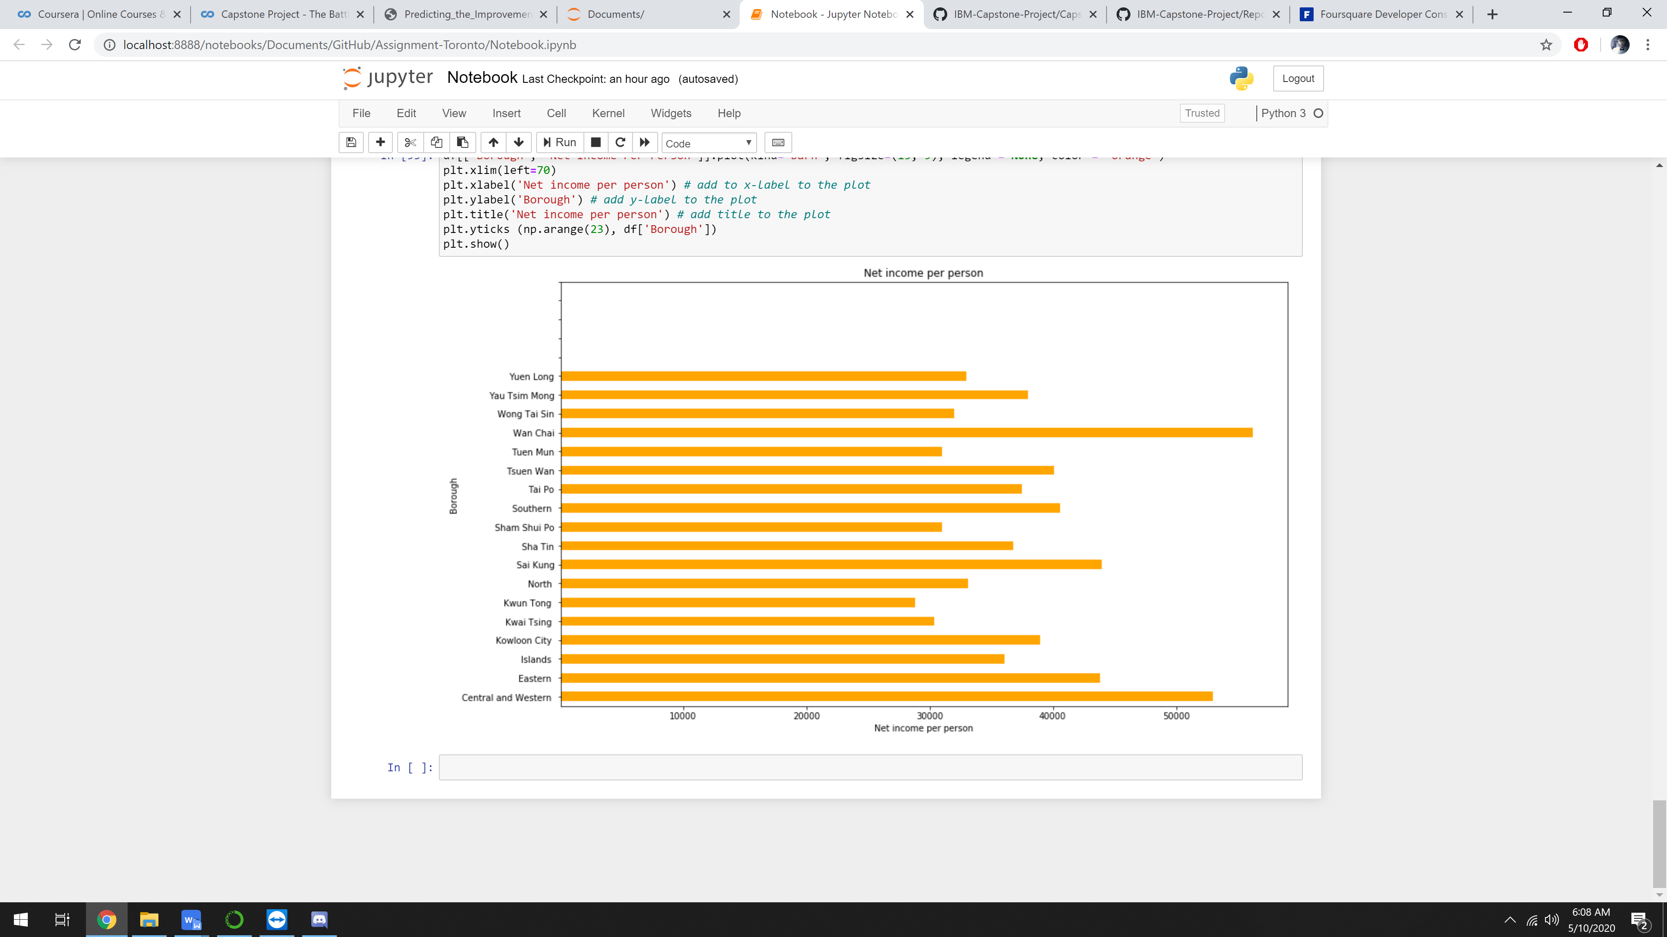
Exploratory Analysis (Net Income Per Person in Hong Kong)

Slide 9
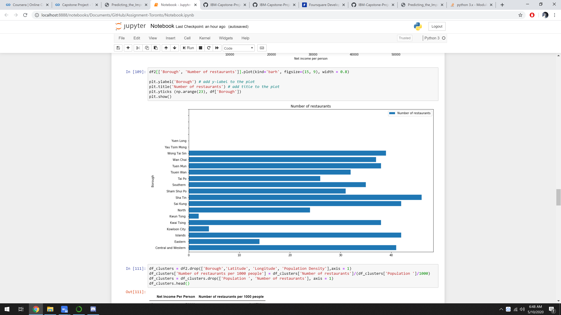
Exploratory Analysis (Number of Restaurants in Hong Kong)

Slide 10
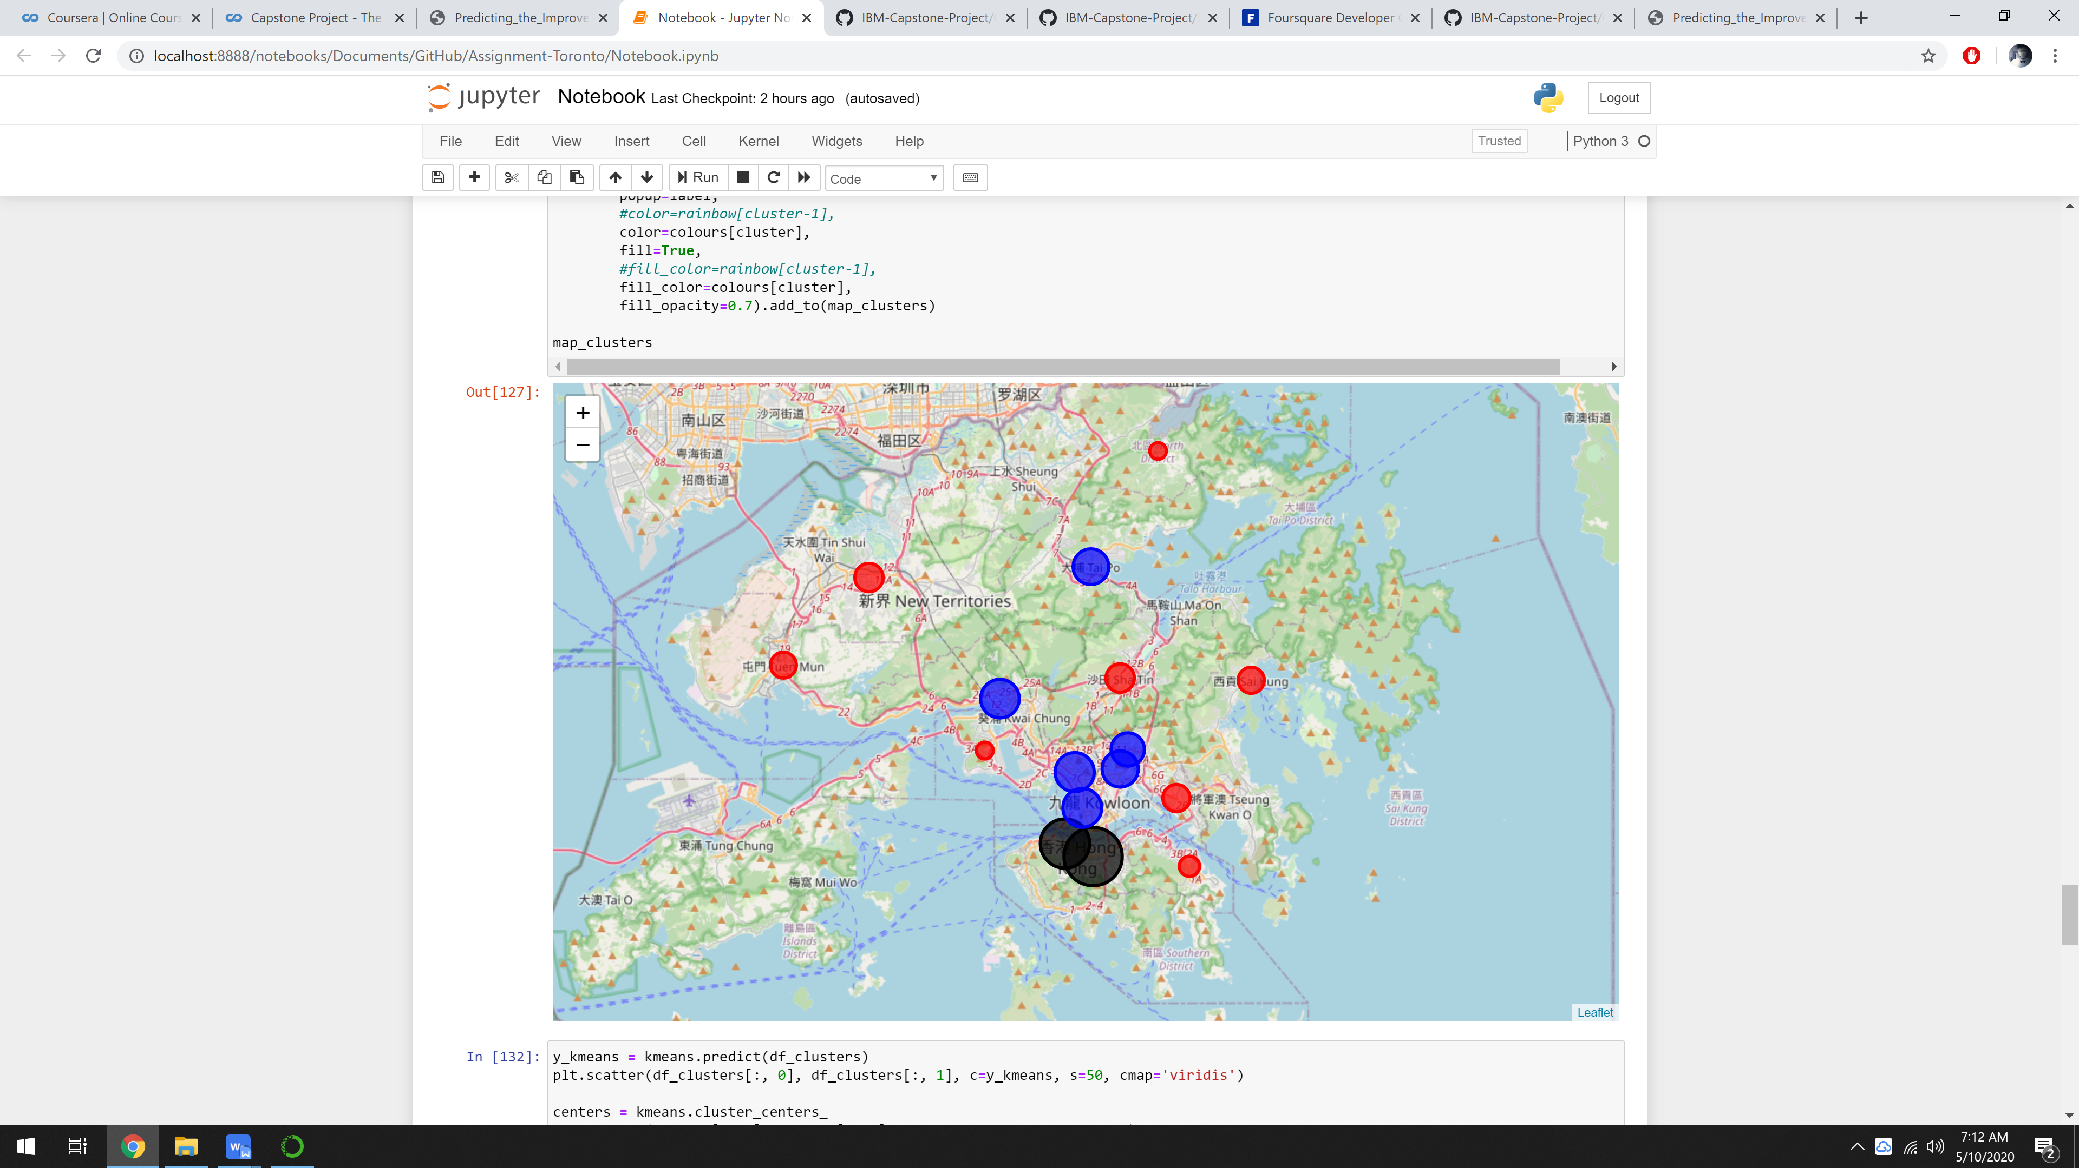
K-Means Clustering

Slide 11
Elbow method was used in order to obtain the optimal number of clusters, and 3 clusters was used.
As you can see on the last slide, there is the two largest clusters (black circle).
The following also contains scatter plots of the normalized data, and the grey circles represent the center of each clusters.

Slide 12
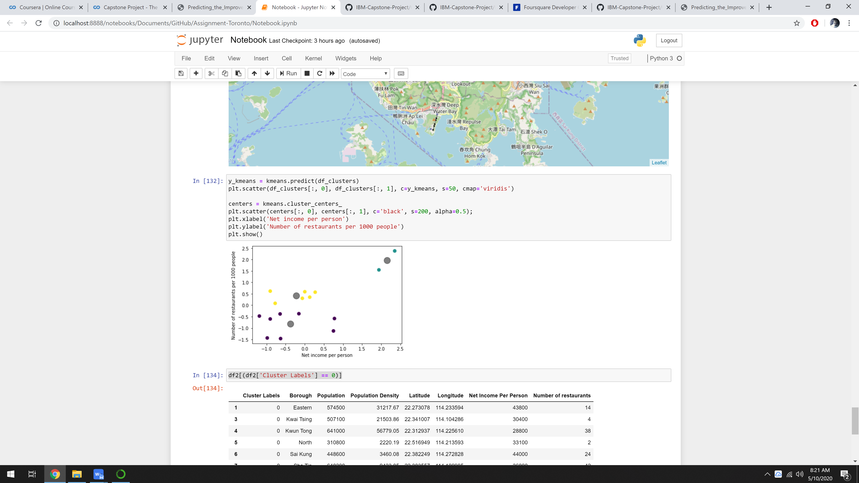
Scatter plot of Clustered Boroughs (Normalized)

Slide 13
As the scatter pot shown, there is an outlier (borough) has a high concentration of restaurants and also with a high net income per person. With the information from above, the outlier boroughs are the Wan Chai and Central & Western cluster.

Slide 14
Results & Discussion
During the analysis, three clusters were defined. To sum up there is one cluster with two borough which is the Wan Chai borough and Central and Western borough, are the boroughs with the highest level of competitions, as there are many other restaurants in these two boroughs compared to other, leading to a high risk investment when it comes to setting up a restaurant in those two boroughs. However, based on the income per person data, it also showed that those two boroughs have a significantly high average income compared to other boroughs, which also means that people in the two boroughs are able to spend more statistically.

Slide 15
Results & Discussion
On the other hand, the blue colored clusters have an medium level of restaurants plus a medium income per person, meaning there will be not as high competition compared to the two boroughs (Black Circle). Therefore, it will make clusters with boroughs Tsuen Wan, Wong Tai Sin, Sham Shui Po, Kowloon City and Yau Tsim Mong ideal to set up restaurants.

Slide 16
Future Directions
This project can be done better by considering other values such as parking places around the location, locations within the clusters and places with the most visits on average. Foursquare doesn't represent the full picture, since many venues are not on the list. For that reason, another maps could be utilized such as Google map or Openstreet map.
Boroughs have too complex geometry, thus defining the closest venues within the certain radius brings additional error to our analysis.

Slide 17
Conclusion
To conclude, the basic data analysis was performed to identify the most optimal boroughs for the placement of the beer restaurant in the city of Stuttgart. During the analysis, several important statistical features of the boroughs were explored and visualized. Furthermore, clustering helped to highlight the group of optimal areas. Finally, Stuttgart Sud and Stuttgart Nord were chosen as the most attractive options for the further analysis.

